Slide 1
MME 351 - Marine Electrical Technology
(2 0 2)
E.A. Frimpong (PhD), MIEEE, MGhIE
Associate Professor at Department of Electrical and Electronic Engineering,
Kwame Nkrumah University of Science and Technology, Kumasi, Ghana

Slide 2
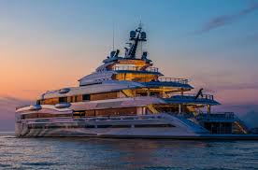
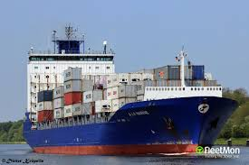
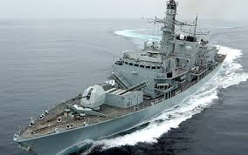

Course aim
To provide insight into electrical technology used in marine vessels.
KNUST-SESC

Slide 3
Course Content
Power generation and distribution: Selection of DC and AC generators, Merits and Demerits of AC and DC. Construction & Characteristics of brushless high speed AC generators with automatic Voltage regulator.
Rules and Regulations governing electrical machinery on ships, location and installation of generator sets. Rating and characteristics of main switch boards. Arrangements of preferential trips and protective devices with wiring diagrams.
System earthing: Isolated neutral systems, resistance earthed system.
KNUST-SESC

Slide 4
Course Content
Motor and Control Equipment: Special requirements of motors and starters for anchor Windlass & Capstan, wiring diagram, lowering & hoisting arrangement, overload protection, magnetic disc, brakes. Centralised control of motors in machinery spaces. Classes of insulation (A, B and E) and Temperature rise.
Starters for miscellaneous electrical equipment for machinery space auxiliaries eg. Sequential starting and cut outs for an automatic fired boiler incorporating safety devices & combustion control equipment. Sequential starting for refrigerating plants, incorporating safety devices like high pressure cut out, cooling water failure cut out, automatic defrosting with help of timer.
KNUST-SESC

Slide 5
Assessment
Continuous assessment (Assignments, quizzes, mid-sem) - 30%
End-of-Semester Examination (MCQs, Written paper) - 70%
KNUST-SESC

Slide 6

Power Generation
and
Distribution in Marine Vessels
KNUST-SESC

Slide 7
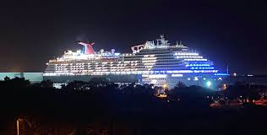
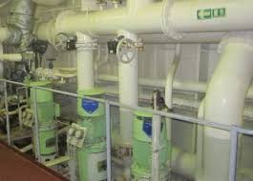
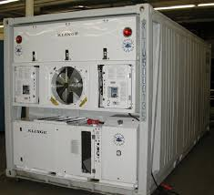
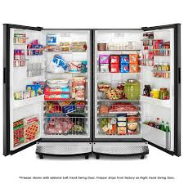
Uses of electricity in watercraft
Lighting
Pumps
Refrigeration
KNUST-SESC

Slide 8
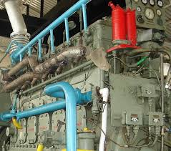
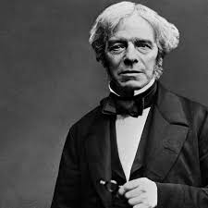
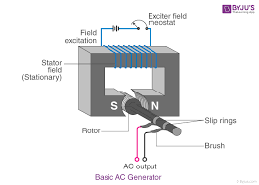
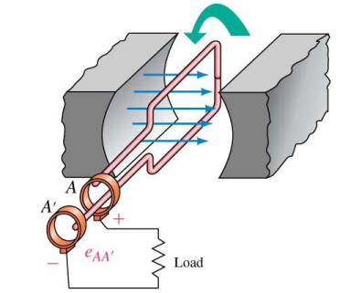
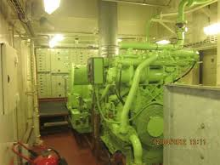
AC generators
Operating principle of AC generators
KNUST-SESC

Slide 9
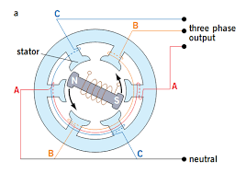
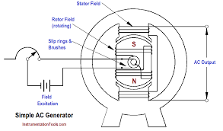
AC generators
Types AC generators
3-phase AC generator
1-phase AC generator
KNUST-SESC

Slide 10
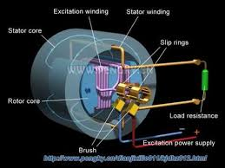
AC generators
Major components
Stator
Rotor
Slip rings
KNUST-SESC

Slide 11
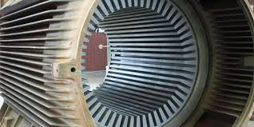
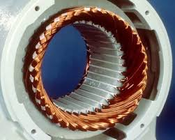
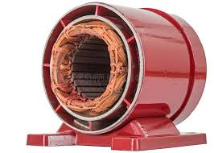
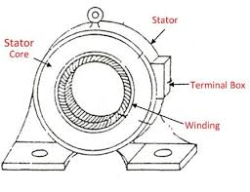
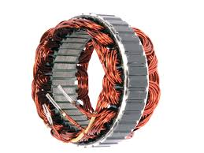
AC generators
Stator
KNUST-SESC

Slide 12
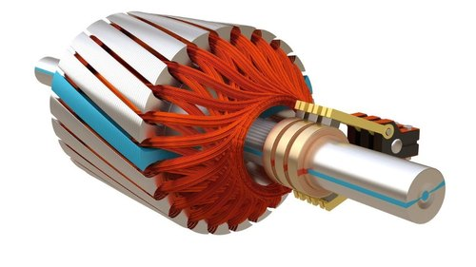
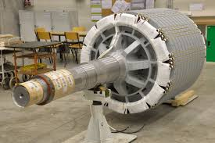
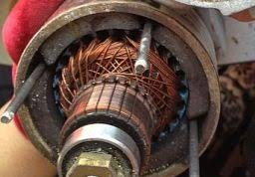
AC generators
Rotor
KNUST-SESC

Slide 13
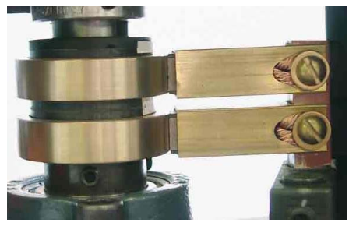
AC generators
Slip rings
KNUST-SESC

Slide 14
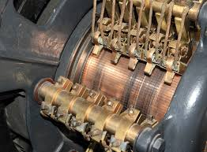
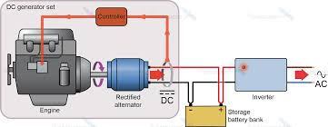
DC generators
A DC generator is essentially a 1-phase AC generator with commutator
KNUST-SESC

Slide 15
AC vrs DC generators
DC Generators
Suitability for large motors
Simple design
AC Generators
Suitability for electrical appliances and small motors
Low maintenance needs
Easy distribution of the output with a transformer
Higher efficiency
Losses are relatively fewer than DC Generators
AC generators can be easily stepped up and stepped down through transformers.
Smaller in sizer compared to DC generators.
KNUST-SESC

Slide 16
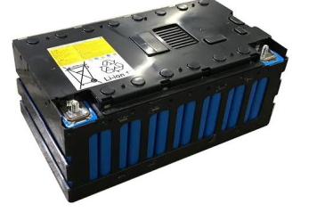
Emergency power supply
Emergency power is needed when the main supply system fails.
Emergency power can be supplied by
Batteries
Emergency generator
Both batteries and generator
Emergency power should cover the following key components and systems
Steering gear system
Emergency bilge pump
Watertight doors
Fire fighting system
Ship’s navigation lights and emergency lights
Communication and alarm system
KNUST-SESC

Slide 17
Location and installation of generators
A solid, level mounting platform is necessary
Adequate space on all sides for ventilation and servicing
Generators must be kept away from living quarters, and away from bilge splash and vapors.
KNUST-SESC

Slide 18
Emergency power supply
Emergency generator is normally located outside the machinery space to provided unhindered access to it.
KNUST-SESC

Slide 19
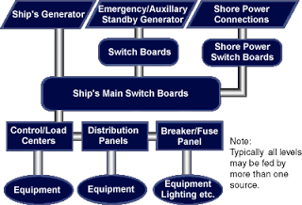
Electrical distribution systems
The power distribution system of a ship is designed to provide a secure supply to all loads with built-in protection for equipment and personnel.
KNUST-SESC

Slide 20
Electrical distribution systems
A ship’s electricity distribution system consists of different component for distribution and safe operation of the system. They are:
Ship generator consisting of prime mover and alternator.
Main switch board which is a metal enclosure taking power from a generator and supplying it to different machinery.
Bus Bars which act as a carrier and allow transfer for transfer of power from one point to another.
Circuit breakers which act as a switch and in unsafe condition can be tripped to avoid breakdown and accidents.
Fuses as safety device for machinery.
Transformers to step up or step down the voltage.
KNUST-SESC

Slide 21
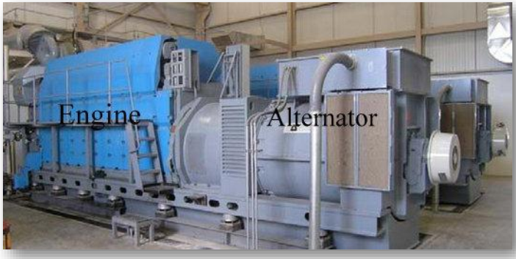
Electrical distribution systems
Generator
KNUST-SESC

Slide 22
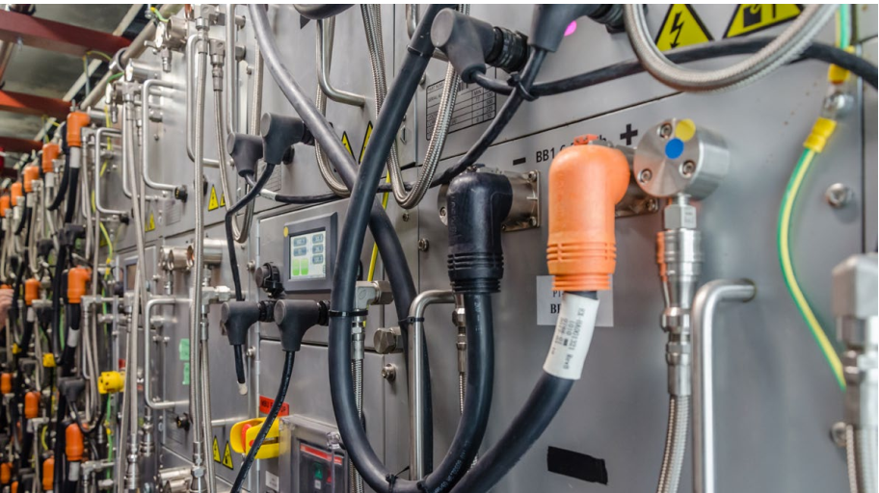
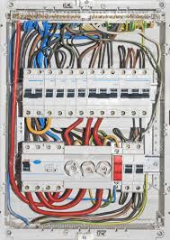
Electrical distribution systems
Main switch board
Domestic
Ship
KNUST-SESC

Slide 23
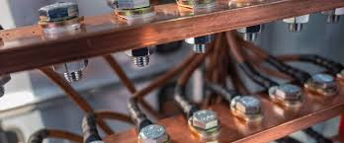
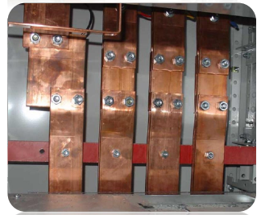
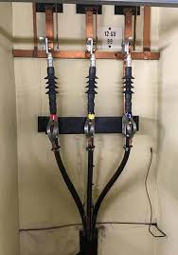
Electrical distribution systems
Busbars
KNUST-SESC

Slide 24
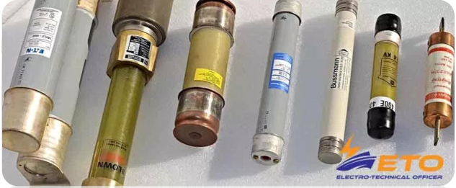
Electrical distribution systems
Fuse
KNUST-SESC

Slide 25
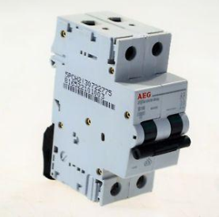
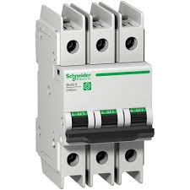
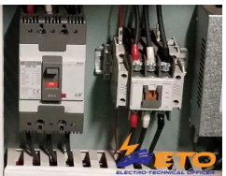
Electrical distribution systems
Circuit breaker
KNUST-SESC

Slide 26
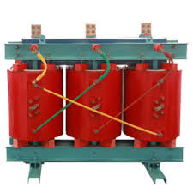
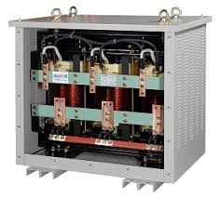
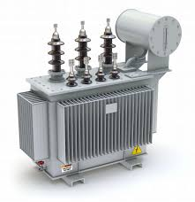
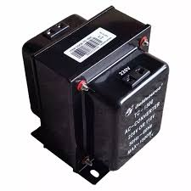
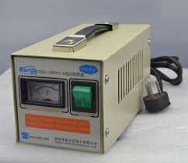
Electrical distribution systems
Transformer
KNUST-SESC

Slide 27
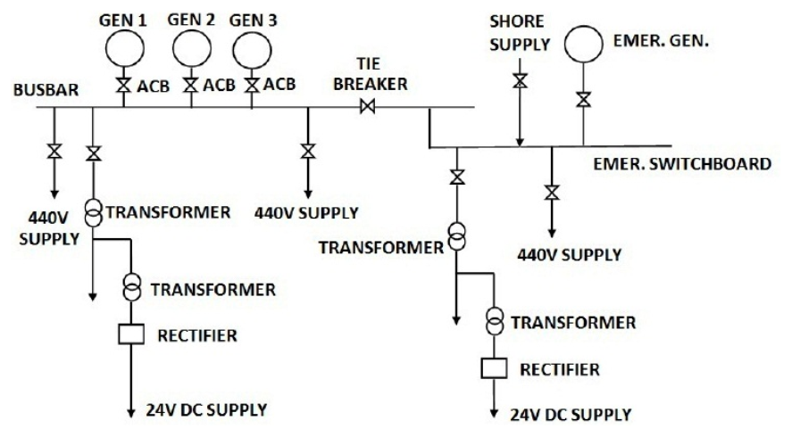
Electrical distribution systems
A typical distribution system for a ship
KNUST-SESC

Slide 28
Emergency switchboard
It is the emergency power distribution center.
It distributes power to auxiliaries that are vital, under emergency conditions
Under normal operation, power for the emergency switchboard is supplied by the main generators through a bus-tie.
In case of power failure, loss of voltage at the emergency switchboard will cause the emergency generator to automatically start.
Simultaneously, the bus-tie will open disconnecting the main and the emergency switchboards.
The emergency generator breaker will close, energizing the emergency board and providing the needed emergency power.
KNUST-SESC

Slide 29
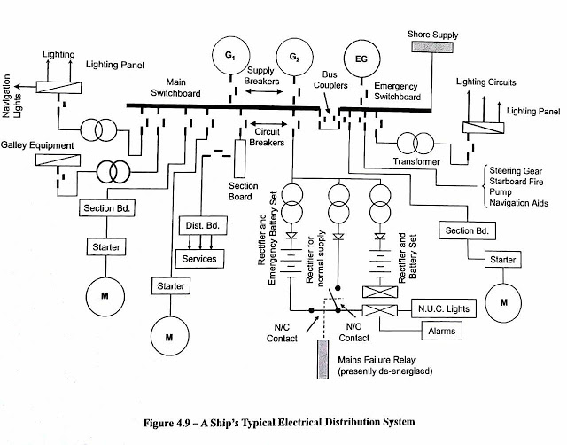
Electrical distribution systems
KNUST-SESC

Slide 30
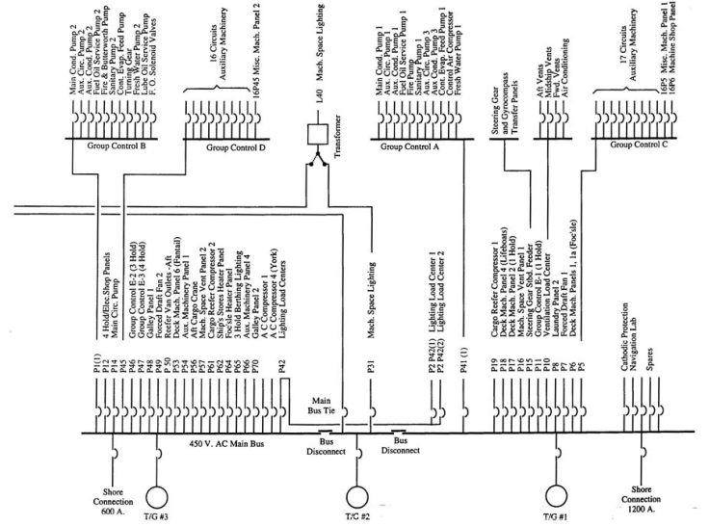
Ship’s distribution system
KNUST-SESC

Slide 31
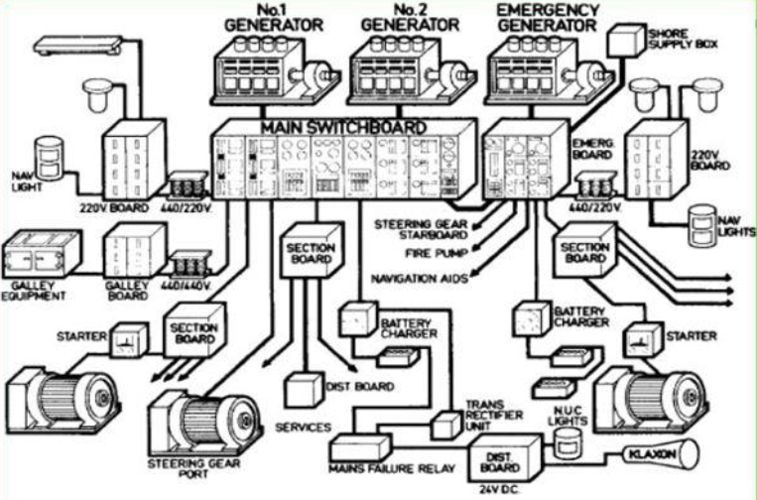
KNUST-SESC

Slide 32
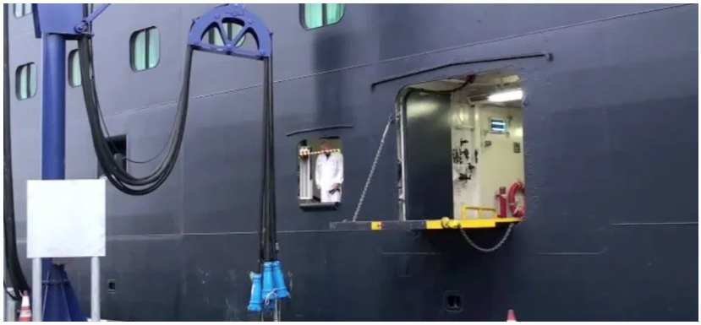
Electrical distribution systems
Ship shore supply
KNUST-SESC

Slide 33
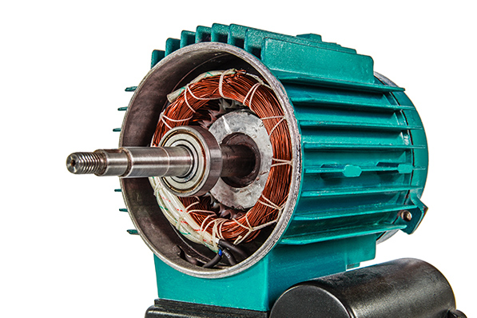
Motors
KNUST-SESC

Slide 34
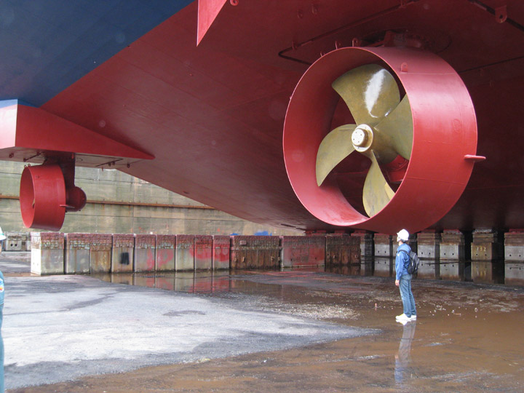

Motors
Uses
Electric propulsion
KNUST-SESC

Slide 35


Motors
Windlass
KNUST-SESC

Slide 36

Motors
Winches
KNUST-SESC

Slide 37


Motors
Pumps
KNUST-SESC

Slide 38


Motors
Fans
KNUST-SESC

Slide 39

Motors
Classes of motors
KNUST-SESC

Slide 40
Motors
Motors used in marine vessels
Induction (Asynchronous ) Motors
Synchronous motors
KNUST-SESC

Slide 41


Induction Motors
They are the workhorses of marine vessels
KNUST-SESC

Slide 42

Induction Motors
They are either single-phase or three-phase type
KNUST-SESC

Slide 43
Induction Motors
Single-phase induction motors
They are powered by single-phase power supply.
They are mostly used in low power applications such as small pumps, small portable compressors and small fans.
KNUST-SESC

Slide 44


Induction Motors
Three-phase induction motors
They are supplied with 3 three-phase AC supply
They are of two types, namely, squirrel cage and wound rotor.
Squirrel cage motors are widely used on ships due to their rugged construction and simple design.
Typical applications of three-phase induction motors are: lifts, cranes, large capacity exhaust fans, engine auxiliary pumps, engine blower fan motor, engine room heavy load pumps including pumps for fire-fighting, freshwater and sea water.
KNUST-SESC

Slide 45
Induction Motors
Advantages of induction motors
They are robust and simple in construction, with few moving parts.
They can efficiently operate in a rugged and harsh environment such as in seagoing vessels.
The maintenance cost of 3-phase induction motor is less; they do not have parts like brushes, commuters or slip rings.
An induction motor can operate in an intrinsic environment as they do not have brushes which can cause sparks that could ignite fire.
3-phase induction motors do not need additional starting mechanism or arrangement as they can generate self-starting torque
KNUST-SESC

Slide 46
Induction Motors
Disadvantages of induction motors
During starting, they draw high starting current, particularly when attached to a heavy load. This causes a dip in voltage during the starting period of the machine.
Induction motors operate at lagging power factor which results in increased power losses and efficiency reduction, especially at low load.
KNUST-SESC

Slide 47

Induction Motors
Potential faults
Environmental faults
Moisture in air
Vibration from heave equipment
Winding faults due to insulation failure
Unbalance supply due to blown fuses
Crawling due to harmonics in supply
Imbalance rotor due to defect in the rotor, internal misalignment, bending of the shaft, uneven loading and improper motor and load coupling.
KNUST-SESC

Slide 48
Induction Motors
Fatigue failure due to improper maintenance, use of poor quality parts, weakening of material caused by repeated load applications.
Bearing failure due to poor maintenance, due to overloading, wrong installation, contaminated lube oil, operation at excessive temperature and water in lubrication (grease).
Lubrication problem due to lack of lubrication or contamination of lubricants leading to can lead to increase friction between parts and bearings.
KNUST-SESC

Slide 49
Induction Motors
Protection of induction motors
Overload protection
Overcurrent protection
Phase unbalance protection
Stalling (locked rotor) protection
KNUST-SESC

Slide 50



Induction Motors
Starting of induction motors
Direct-on-line starting
Resistance starting
Auto-transformer starting
Star-Delta starting
KNUST-SESC

